Slide 1
SPRAY
-Efficient Irrigation System-
Myungwoo Yang Jeongjun Lee Subeen Jeong Connor Polanka
Notes:
Hi I’m Jeongjun Lee.
It is the second time to present in English.. I am very nervous. Because I messed up the previous presentation.
Ok Let’s start. Our project is to build an efficient automatic irrigation system.

Slide 2
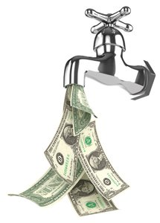
Introduction
Water waste
Excess water will evaporate or seep under the ground.
Water is important resource.
Low Power
Reduce system electricity needs and costs
Notes:
To begin with, I’d like to start by looking for problems.
First, Waste of water, water is important for plants to grow.
But if you give a plant too much water, the water will evaporate or seep under the ground.
It is an financial loss.
Second is Low Power.
The cost of running the system should be low, saving more money
With low power, system has a possibility of running on solar power.

Slide 3
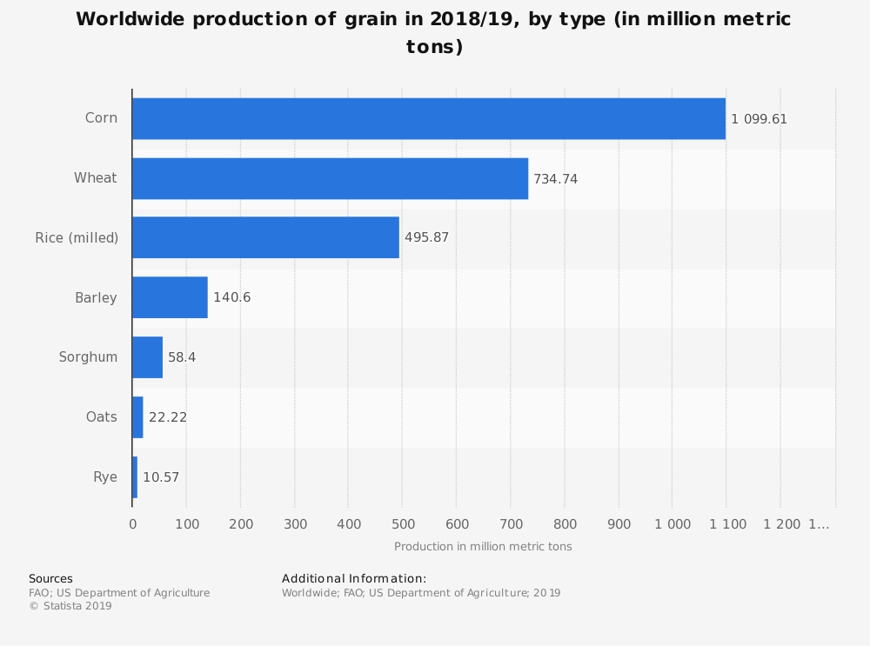
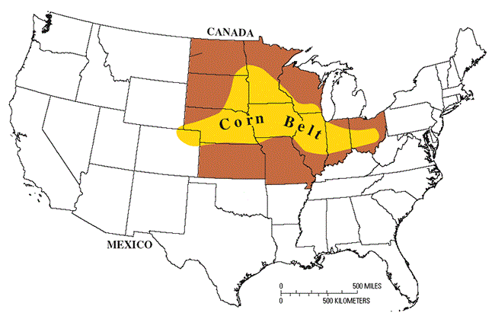
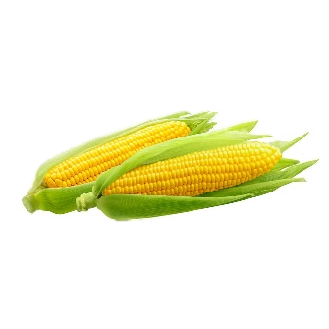
Introduction
Main Crop : Corn
Widely cultivated in the world
Corn require a lot of water
Corn is the dominant crop in the midwestern US
Notes:
Our Main Crop is Corn. Why did we choose the corn? Because corn is widely cultivated in the world and also most produced in the world.
As you can see, Corn is the dominant crop in the midwestern US. It has even been called the corn belt.
So. We thought our study will have the greatest impact on corn.

Slide 4
Introduction
Our Method
Low power network – LoRa
How to reduce water waste - MAD
Notes:
Then, how to solve this problem.
We tried to solve it using LoRa and Mad.

Slide 5
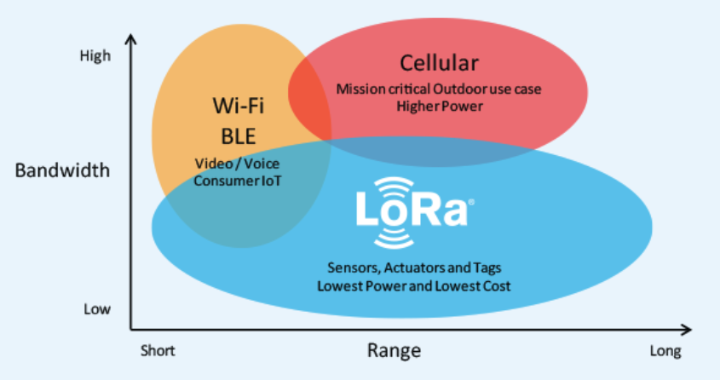
Our Method
LoRa
LoRa (Long Range) is a low-power wide-area network (LPWAN) technology
Low power wide area networks – wireless
Slow data rate (compared to 4G or 5G)
Long communication distance
Energy efficiency
Notes:
LoRa is low power wide area network. So We thought it was the best thing for our system.
Let’s check LoRa’s characteristics.
Its data rate is slower than 4G or 5G, but communication distance and energy efficiency is better than them

Slide 6
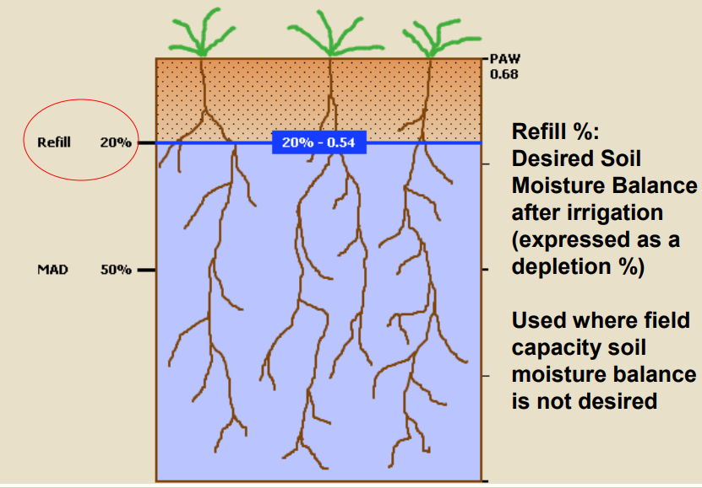
Our Method
Management allowable depletion(MAD)
Lowest soil moisture a plant can withstand without water stress
Irrigation system set to water when MAD is reached
Notes:
What is the MAD? MAD definition is management allowable depletion.
it means Lowest soil moisture a plant can withstand without water stress
This is the zero percent depletion point. Over time, soil dries out. Depletion points are getting higher.
When the depletion points reaches MAD, irrigation system begins adding water.
PAW – Plant Available Water

Slide 7
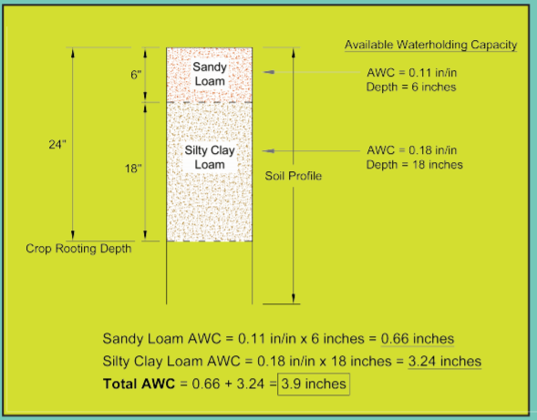
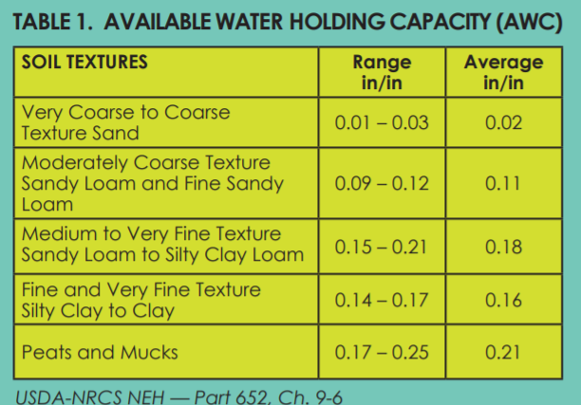
Our Method
MAD auto-irrigation algorithm
Notes:
To irrigate, We need to know how much water the soil can hold. So AWC is available water holding capacity.
And AWC Depend on soil type. For example.
This part is sandy loam. Sandy loam average awc stands for 0.11 in water inches per soil inches.
So this part’s awc is 0.66 inches
And this part silty clay loam 0.18 value silty clay loam awc is 3.25 inches
So Total AWC = 0.66 + 3.24 = 3.9 inches.

Slide 8
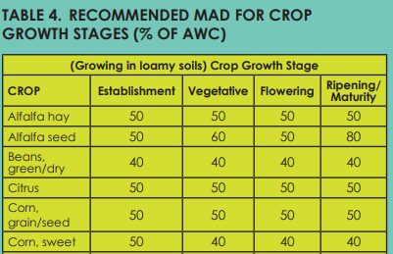
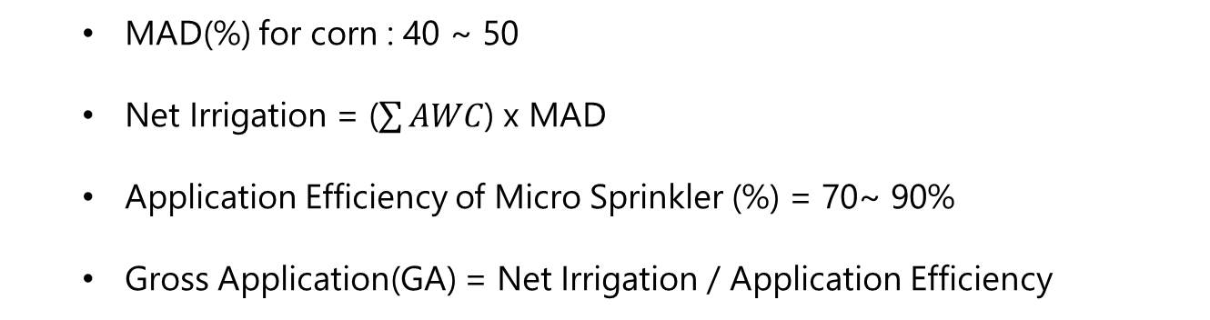
Our Method
MAD auto-irrigation algorithm
Irrigation Set Time
MAD(%) for corn : 40 ~ 50
Net Irrigation = ($\sum{AWC}$) x MAD
Application Efficiency of Micro Sprinkler (%) = 70~ 90%
Gross Application(GA) = Net Irrigation / Application Efficiency
Notes:
You can know how much you have to water using MAD.
First you can find mad value in this table. This table shows the recommended MAD values for each crop at each stage of its life.
Net irrigation is total awc times mad.
If you have lower efficient sprinkler, you should give more water so GA will be higher.

Slide 9
Our Method
MAD auto-irrigation algorithm
GA = Gross Application
A = Area, square feet
Q = Flow Rate per plant, gallons per hour
T = (GA x A) / 1.6 x Q
T is an irrigation set time. Unit hour
Notes:
We have already got the GA.
A is irrigation Area.
Q is flow rate per plant.
So we use this formula. We can know how long we have to irrigate.

Slide 10
2020 IITP MID PRESENTATION SPRAY SMART IRRIGATION SYSTEM.
OUR SYSTEM
Notes:
Ok. Now I explain our system.

Slide 11
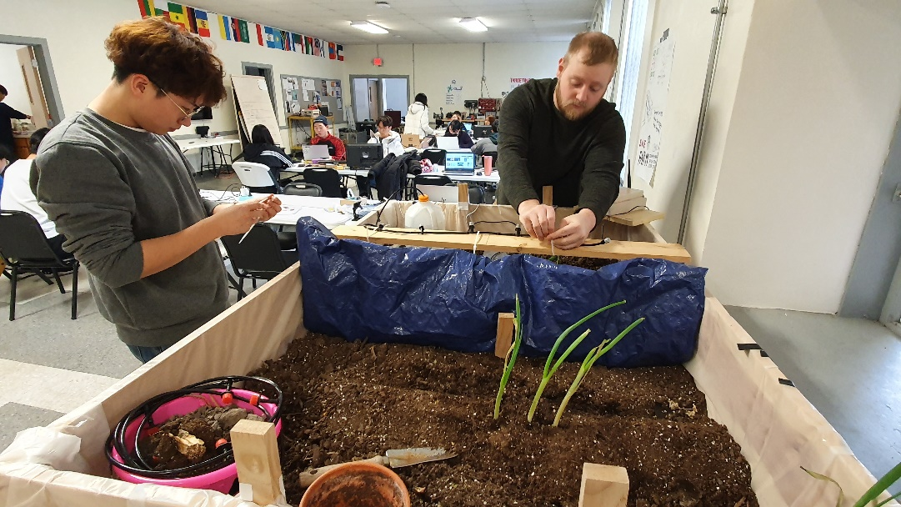
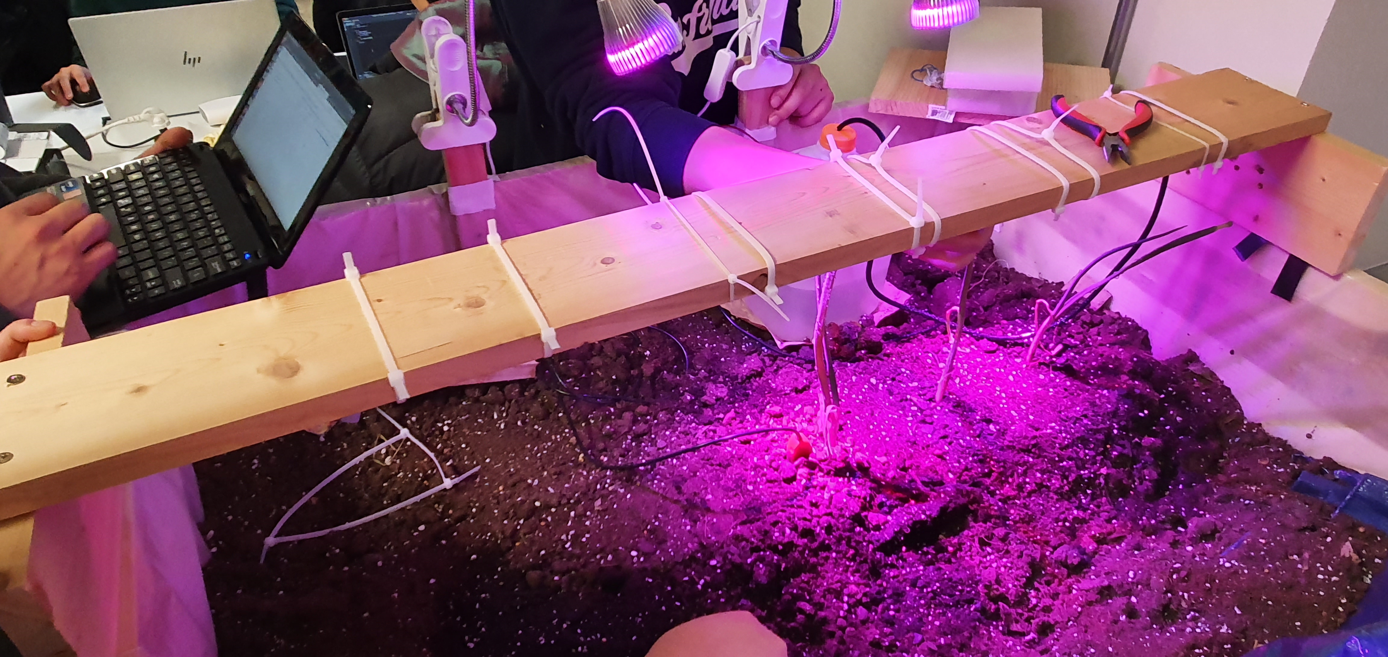
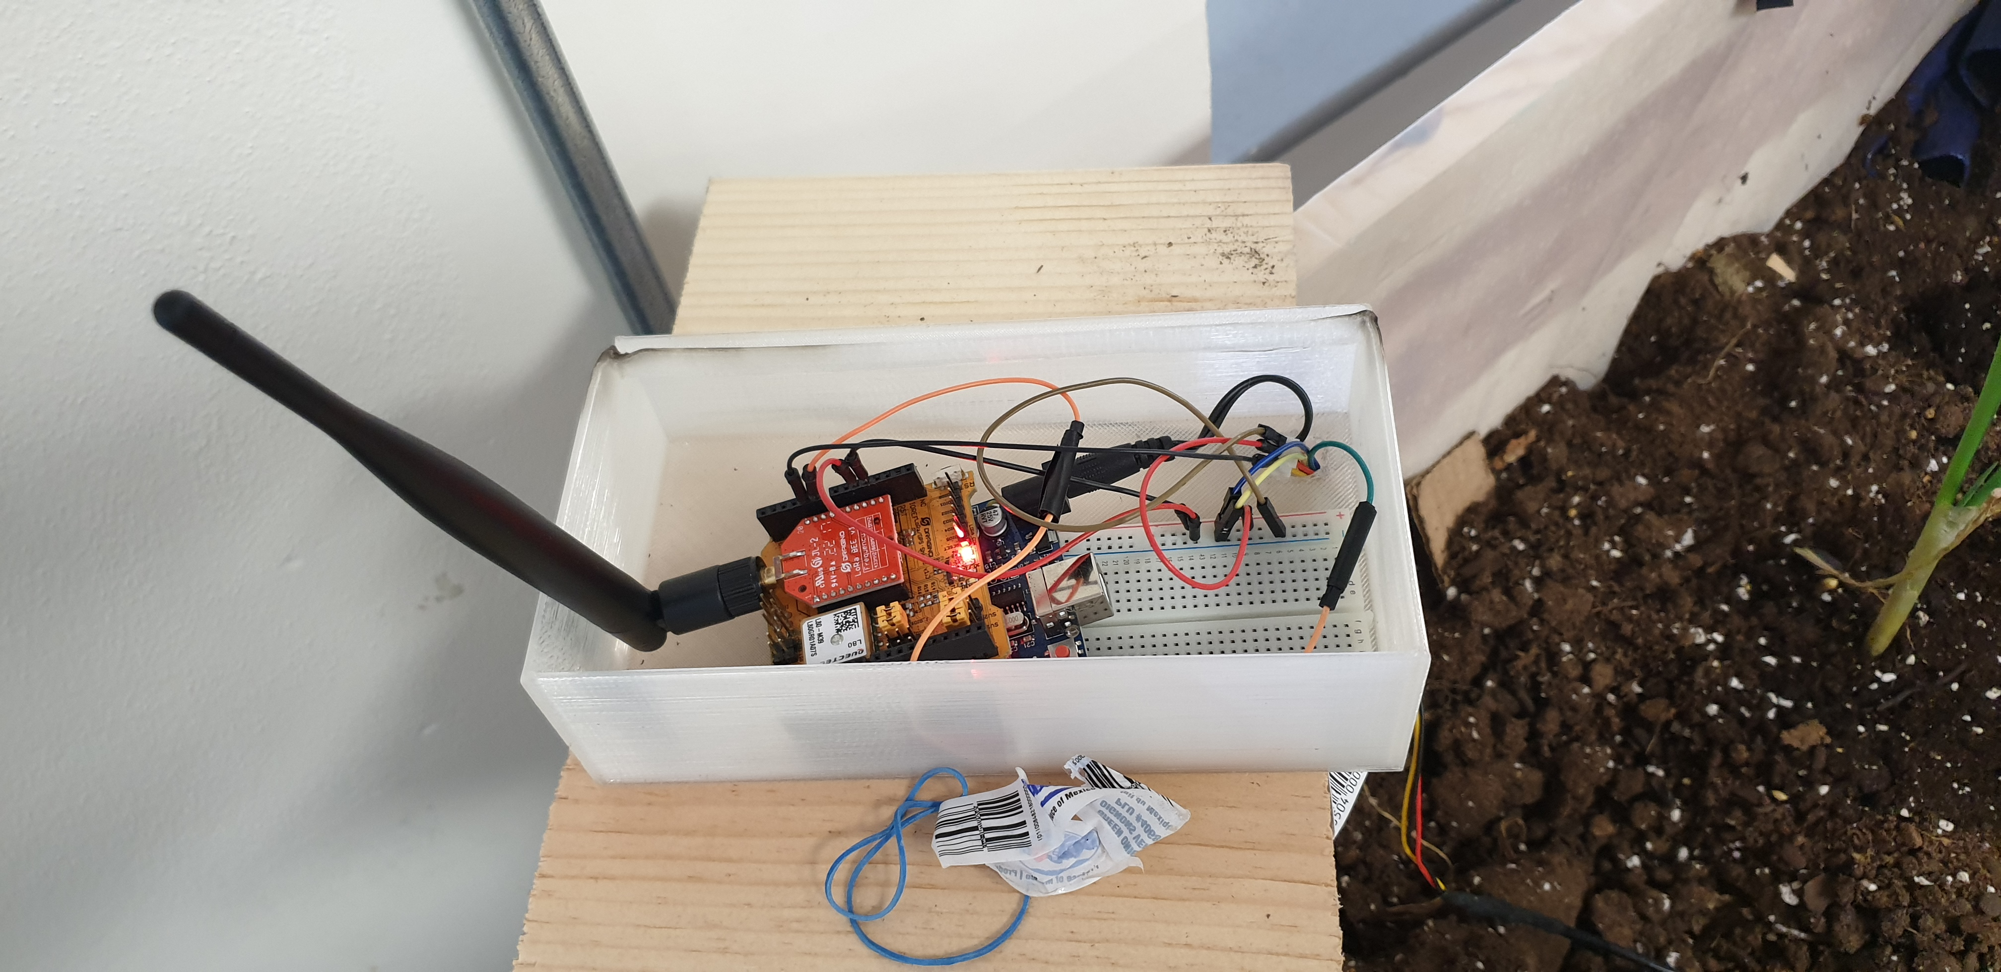
Our System
https://youtu.be/ziH4H-jZAgs
Notes:
It is

Slide 12
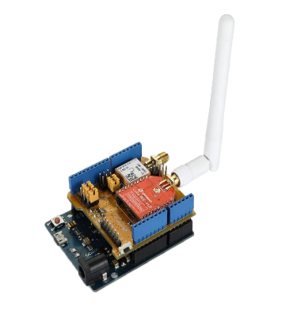

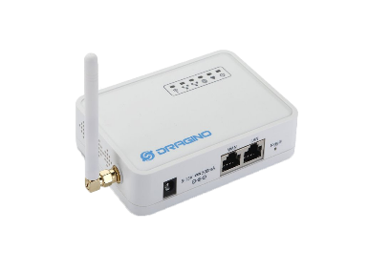
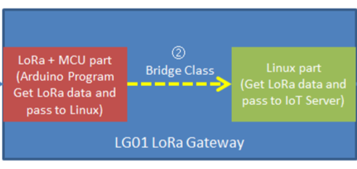
Structure
data storage
Sensing Data
End Node
(LoRa Shield & Bee)
LoRa Gateway
Internet
Server
Data Sensing
Humidity, soil moisture, temperature
Connect between
LoRa and Internet
Control Action
Notes:
We made the automatic irrigation system until now.
Let’s see how to gather data.
1. End node check the field's temperature, humidity, soil moisture.
2. Then, End node and Gateway is connected by using LoRa. Radio head library’s functions make the connection wireless. Sensor data is sent every 15 second.
3. Then, inside of Gateway, Bridge library pass Lora data to Linux part from Microcontroller.
4. Finally, Process library sends data to Thing-speak website.

Slide 13
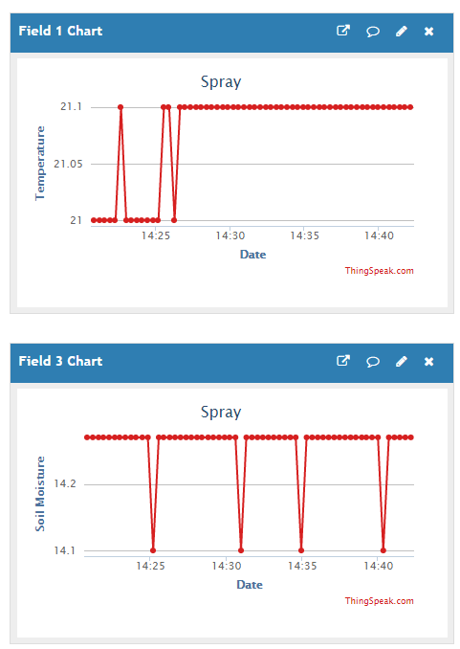
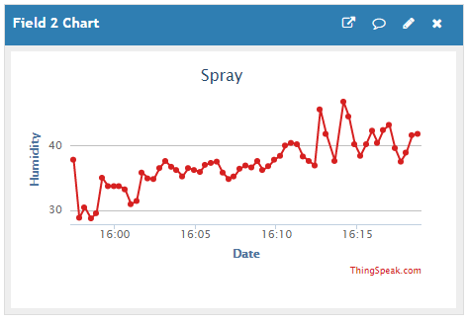
Thingspeak
Collect
Data
The site stores the temperature, humidity and soil moisture data obtained. And shows data using dot graph, and you can get data using REST API
Notes:
The website shows data using dot graph, and you can get data using REST API.

Slide 14
Structure
End Node
(LoRa Shield & Bee)
LoRa Gateway
Internet
Server
Action
irrigation
Connect between
LoRa and Internet
Send Packet
Control Action
Notes:
Come back structure,
So what about irrigation control?
First, the server observes the data. If the data match irrigation conditions, the server send packets to the LoRa Gateway using REST API.
2. Then, when Bridge receives a packet, The gateway passes it to the end node.
3. Finally, the end node begins irrigation.

Slide 15
Django
Soil Moisture
MAD
Period
Irrigation Control
Back-end
Server
The server determines when and how much to irrigate by considering MAD, soil moisture, and period.
Notes:
The server determines when and how much irrigate by considering MAD, soil moisture, and period.

Slide 16
Summary
What we did
Researched how to effectively water and reduce water waste.
Gathered sensor data using LoRa.
Controlled irrigation.
What to do further
Research relation between soil moisture and MAD.
Consider each stage of corn’s life cycle and weather API
Test in a small farm.
Notes:
to sum up , what We did until now.
First search how to effectively water and reduce waste of water.
Second gather sensor data using LoRa.
Third control irrigation
what we're going to do,
First, search relation between soil moisture and MAD.
Second, consider corn’s each level of growth
Third, Test in the small farm.
Last, use weather api

Slide 17
THANKS FOR
YOUR ATTENTION

